Slide 1
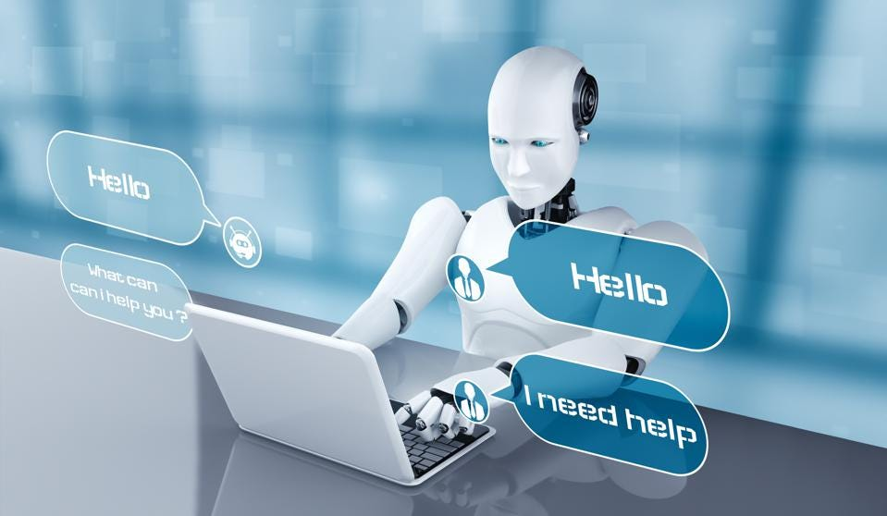
PRESIBOT REVIEW - 2
Rasa is an open-source chatbot framework based on machine learning. with the help of it, we can easily create highly accurate chatbots and can easily integrate these chatbots with our website, telegram, facebook, whatsapp, etc.

Slide 2
Technologies used to build chatbot.
RASA
HTML5
CSS3
JavaScript
Database

Slide 3
Uses of ChatBot.
Developing HR chatbot that interact with employees and assist them with routine tasks and queries.
Chatbots are of immense use in HR departments, and by taking over routine tasks - they can help improve the productivity of HR employees.
Being closer to employees.
It is capable of managing a variety of use cases across all functional categories and can be both proactive and reactive. For workers who get annoyed attempting to navigate various tools and portals to get what they need, this is a game-changer.

Slide 4
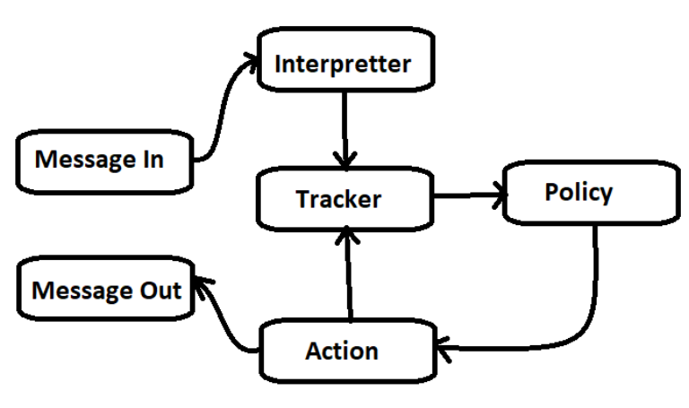
RASA Architecture

Slide 5
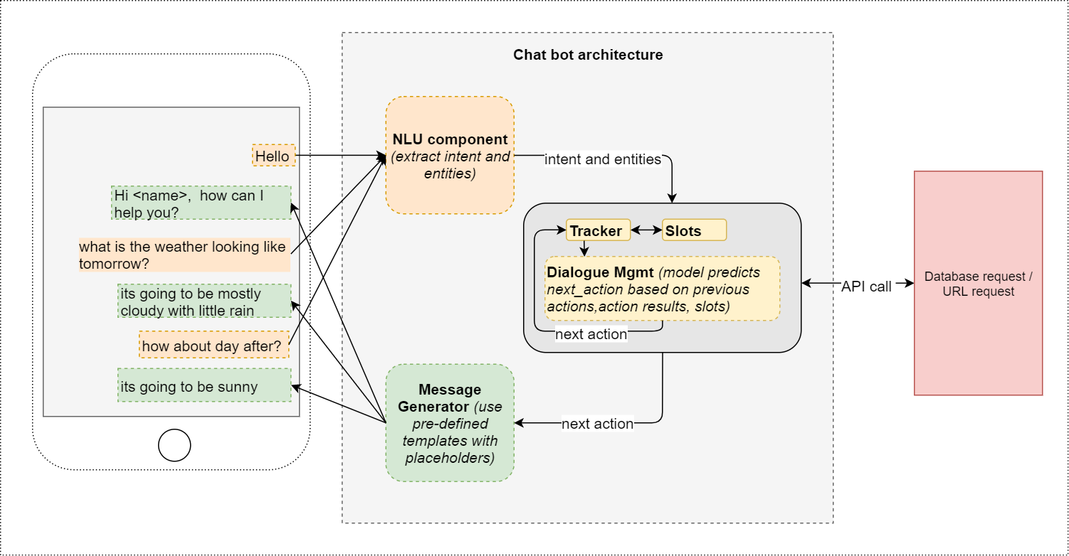
Chatbot Architecture

Slide 6
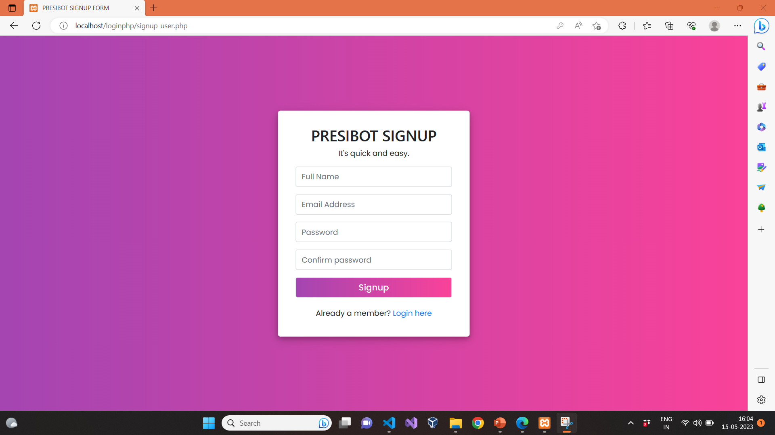

Slide 7
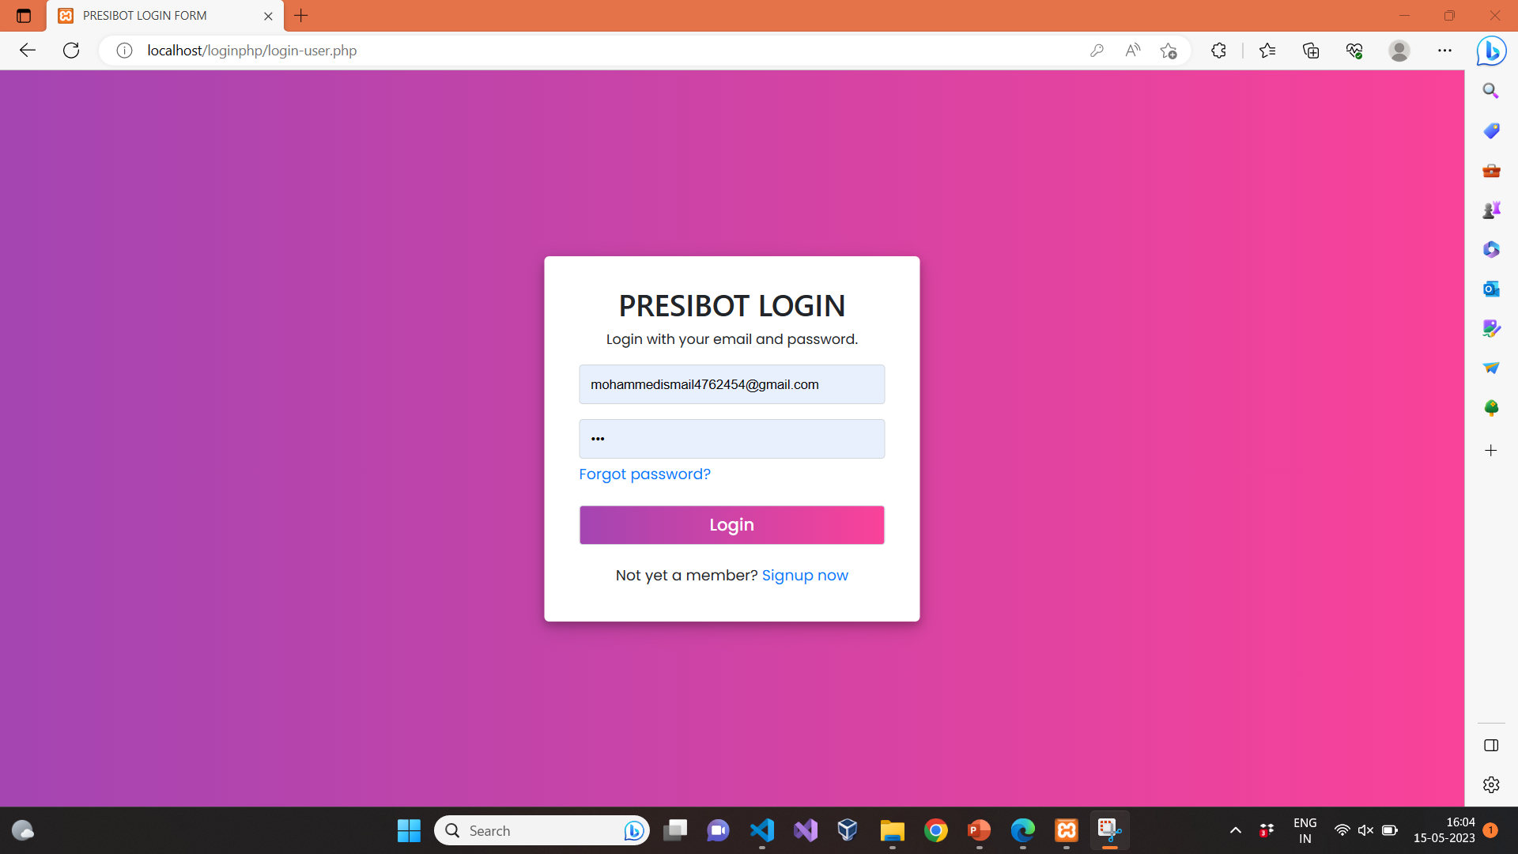

Slide 8
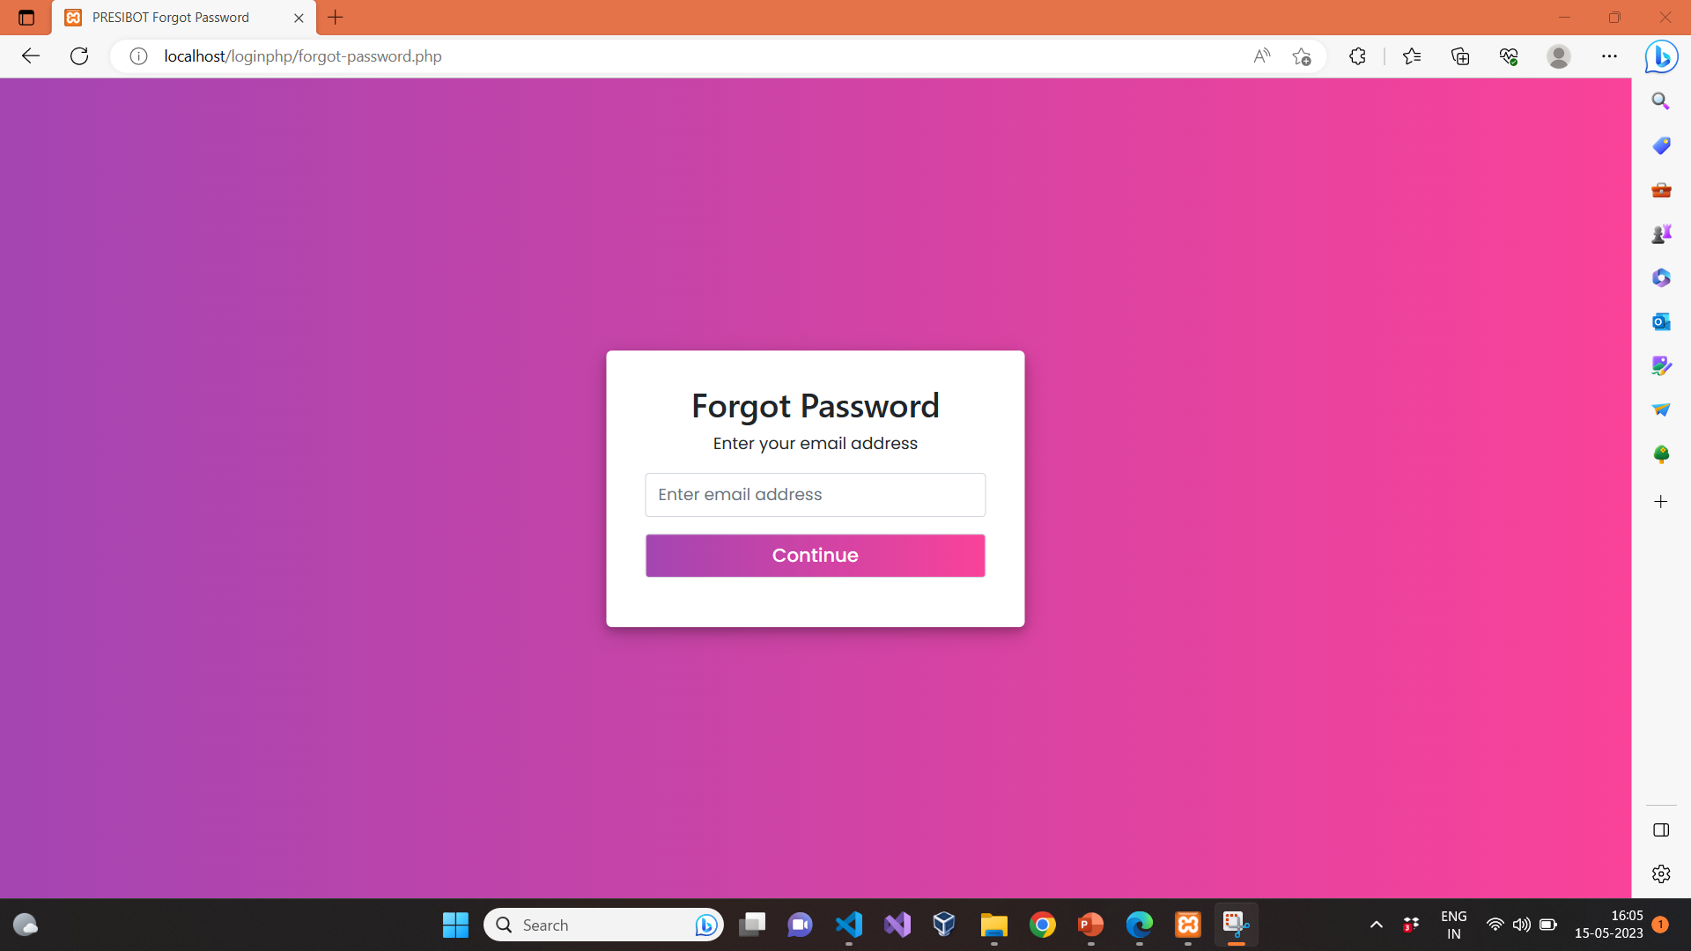

Slide 9
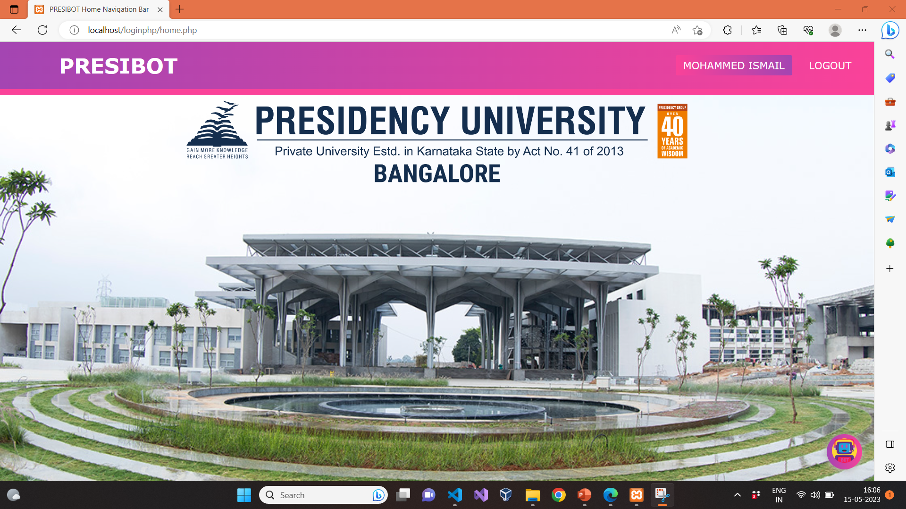

Slide 10
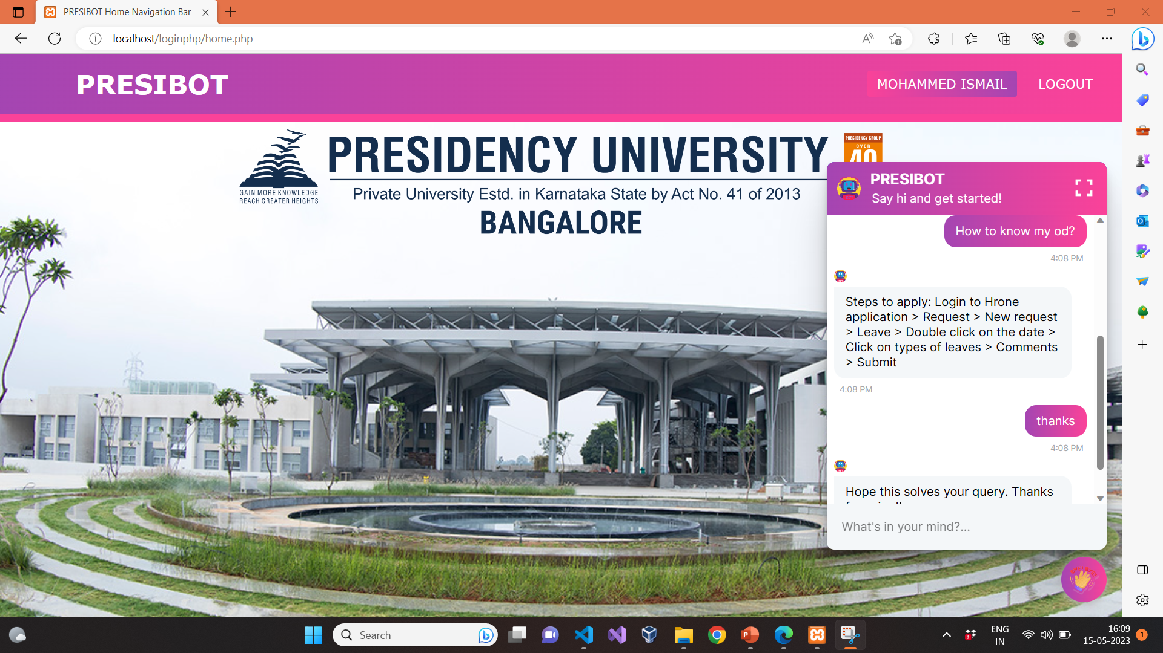

Slide 11
